Slide 1
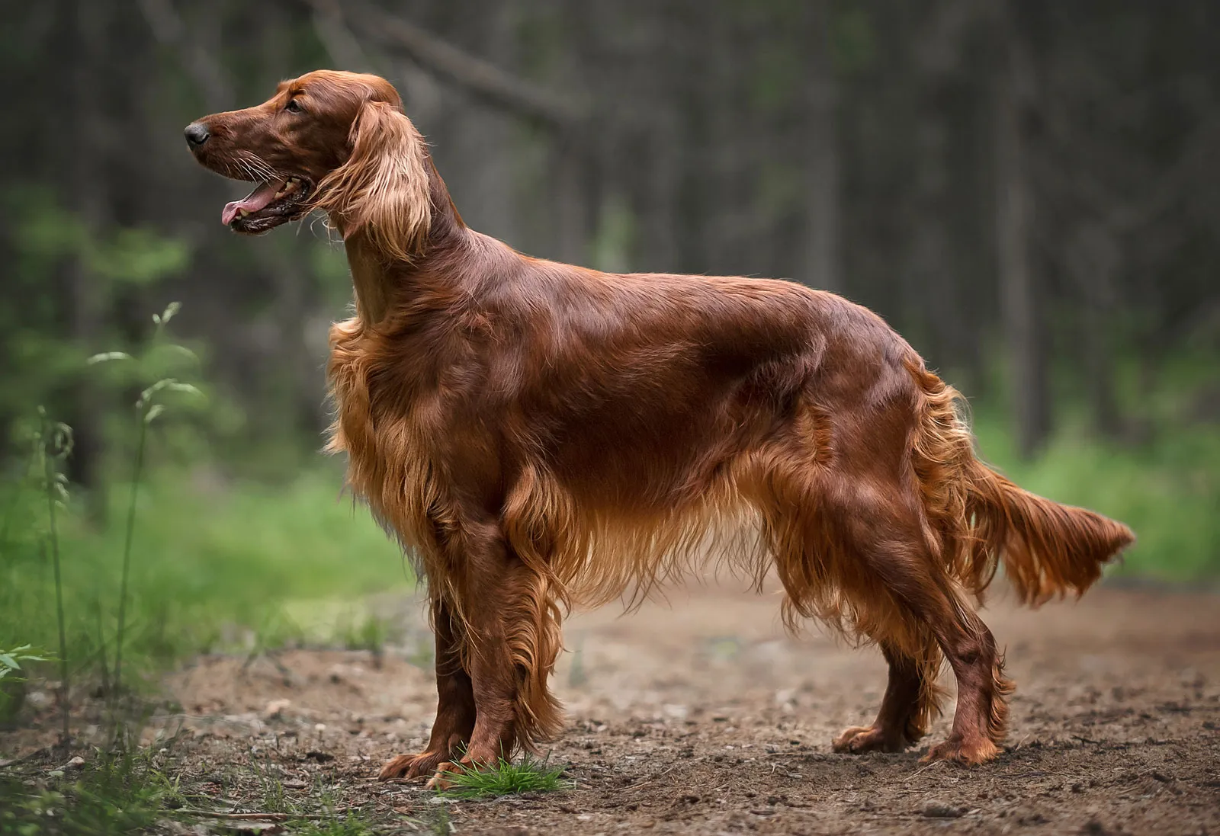
Notes:
Irish setter

Slide 2
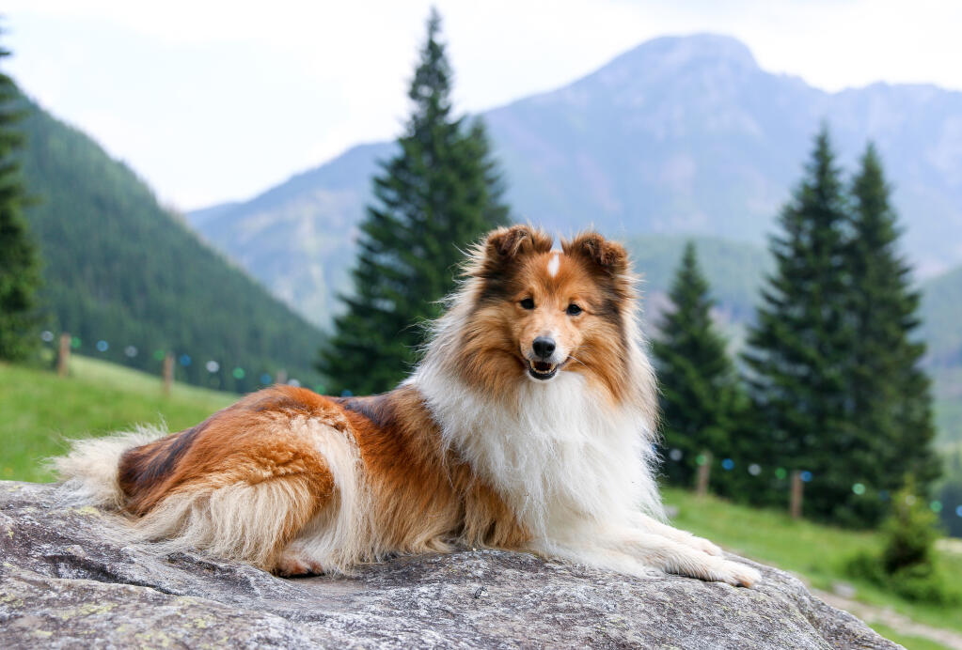
Notes:
Shetland Sheepdog

Slide 3
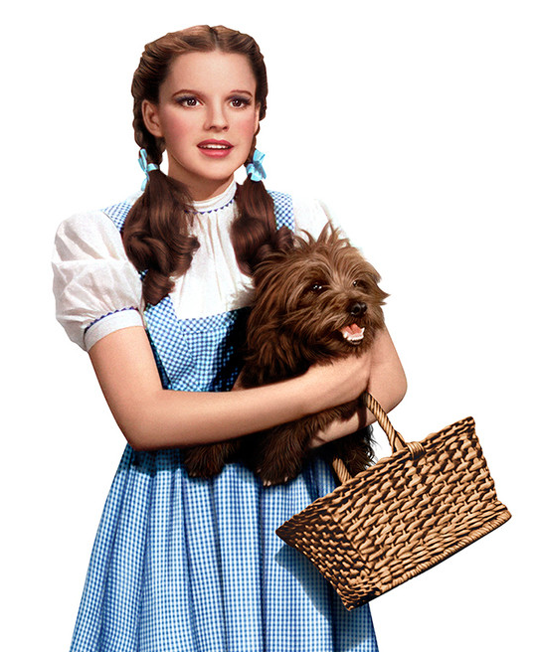
Notes:
Toto

Slide 4
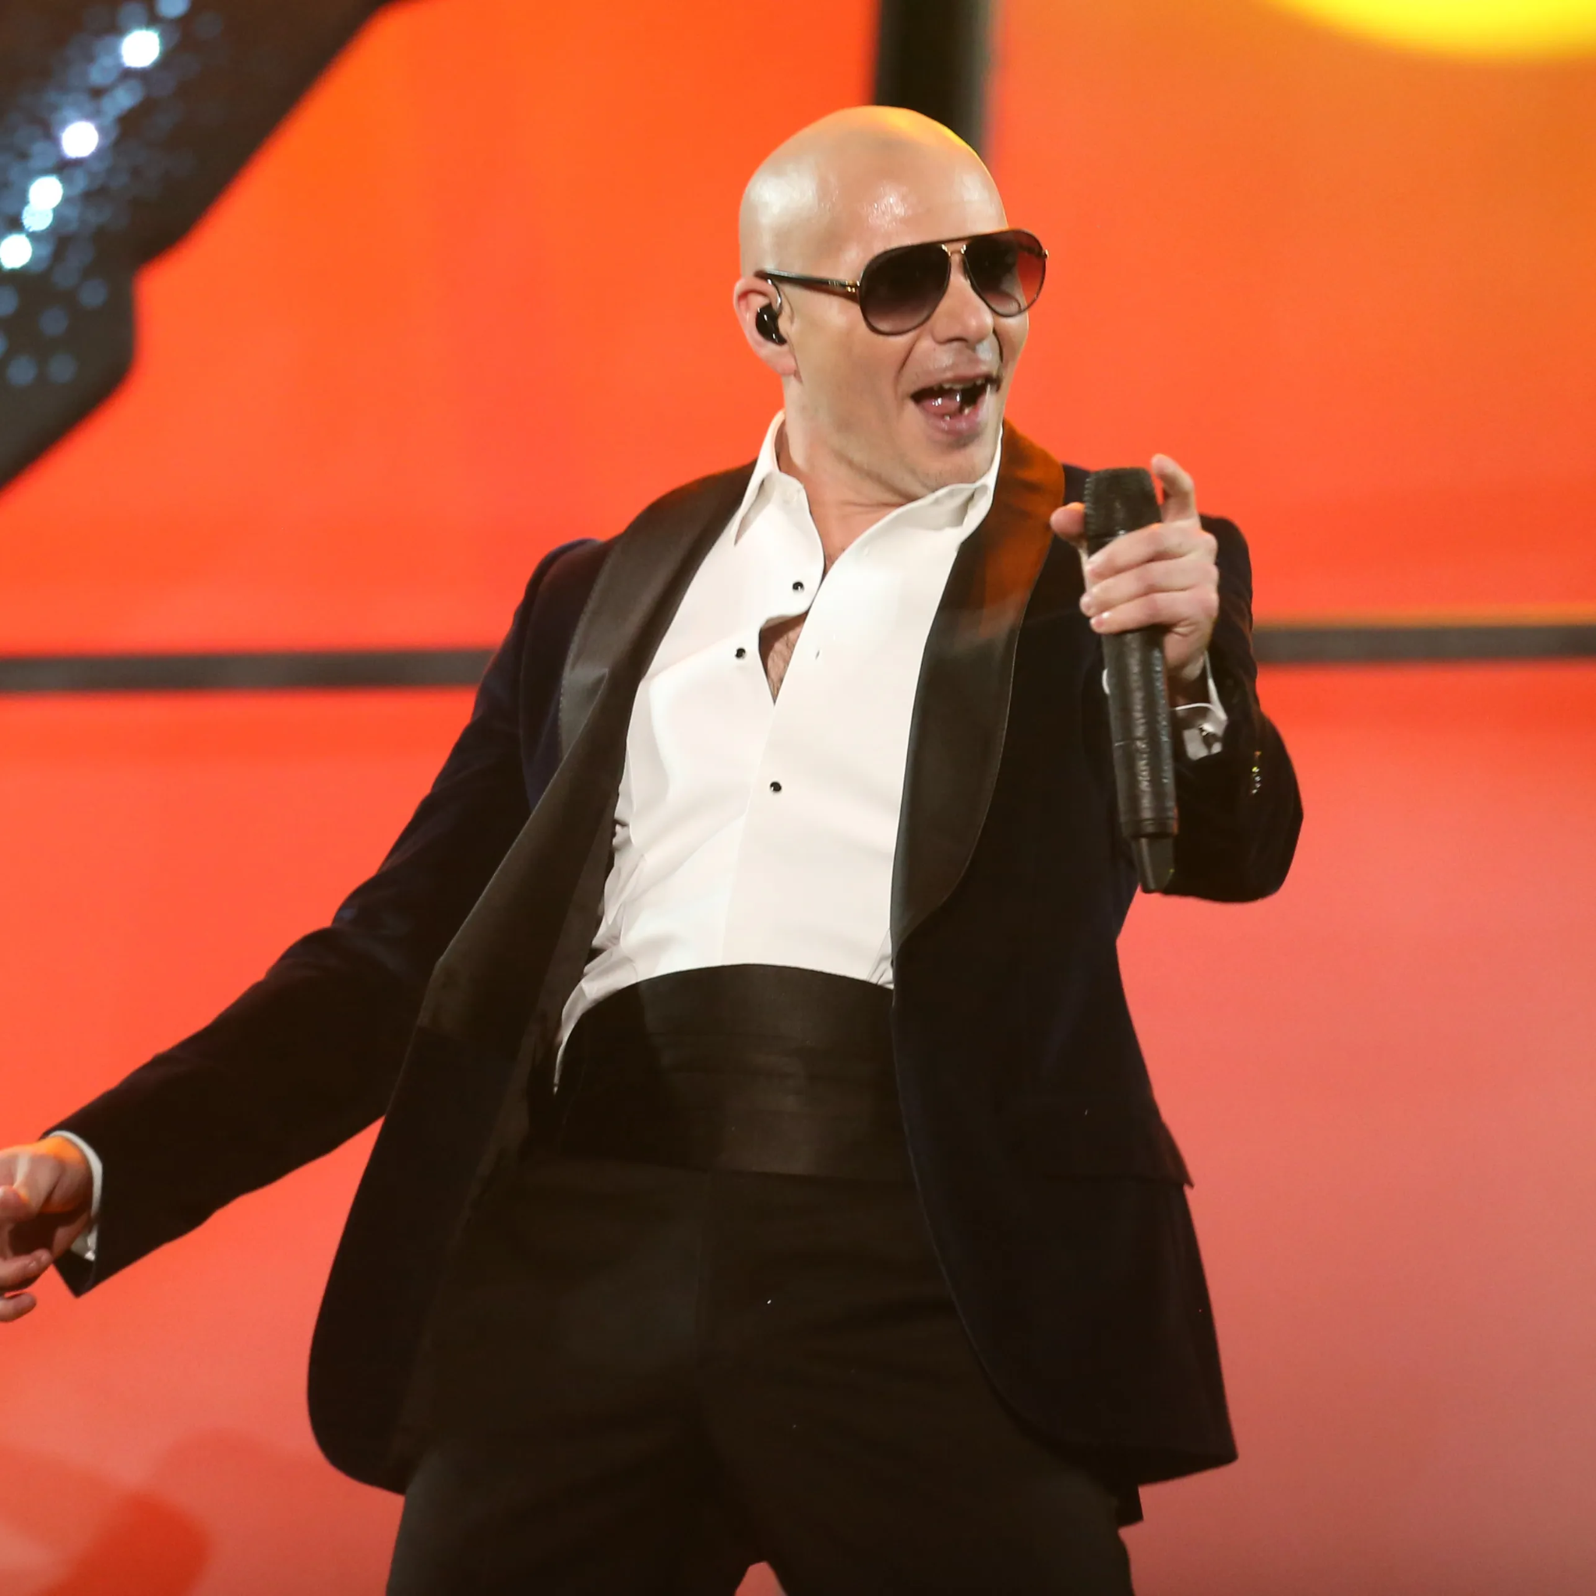
Notes:
Pitbull

Slide 5

Notes:
Brian Griffin

Slide 6
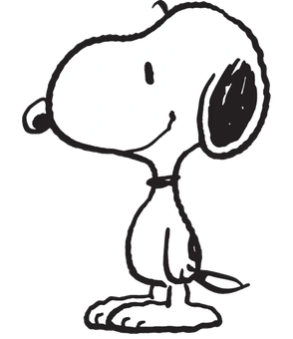
Notes:
Snoopy

Slide 7
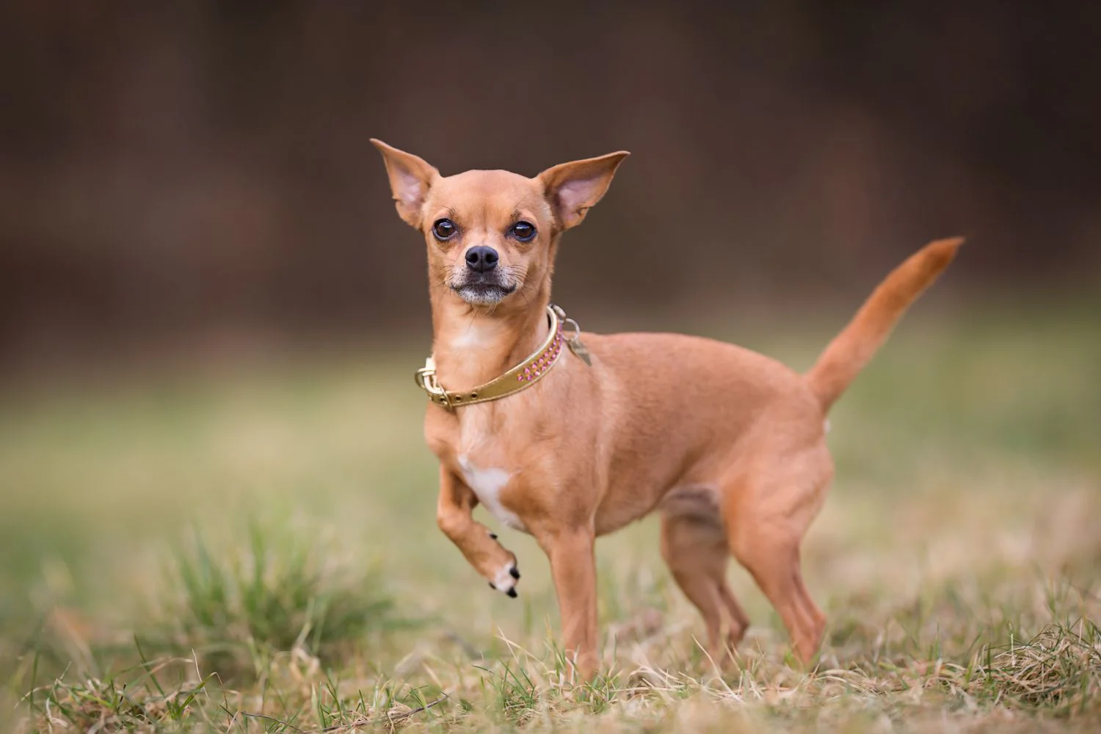
Notes:
Chihuahua

Slide 8
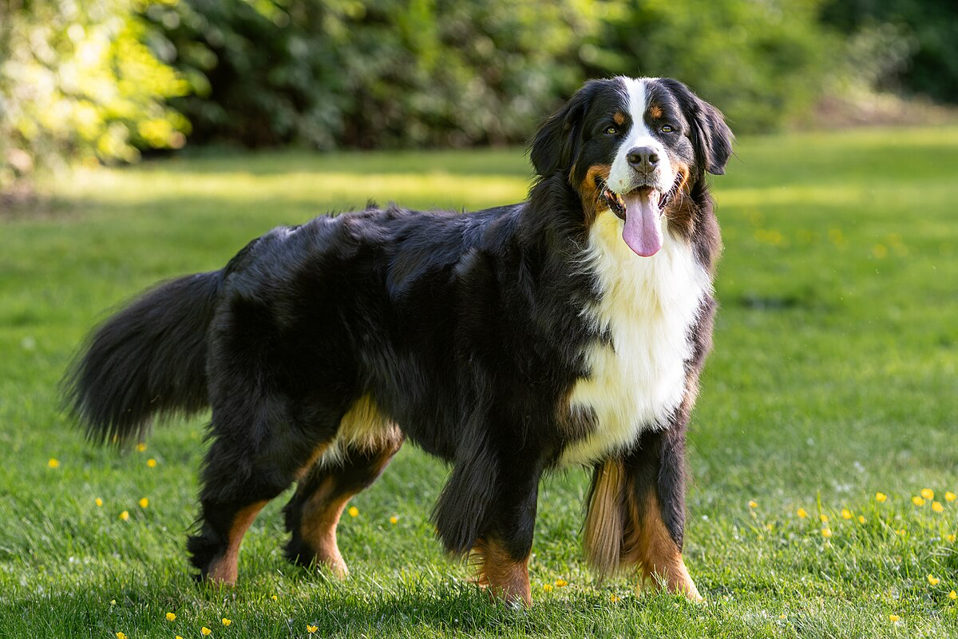
Notes:
Bernese mountain dog

Slide 9
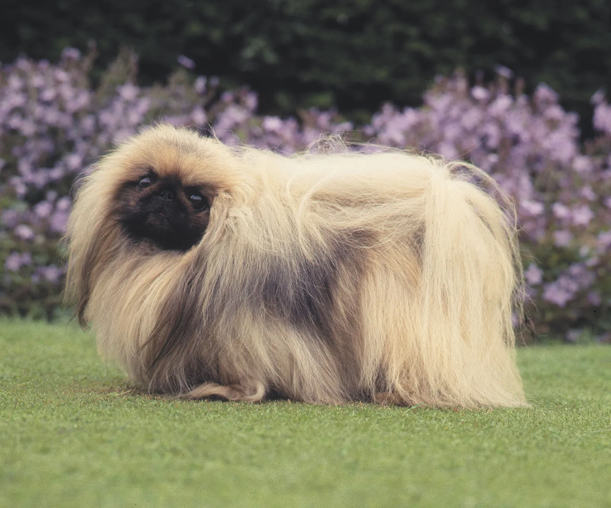
Notes:
Pekingese

Slide 10
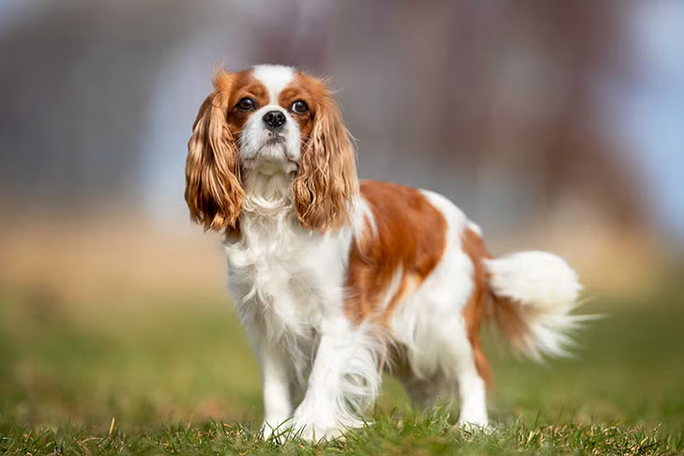
Notes:
Cavalier King Charles Spaniel

Slide 11
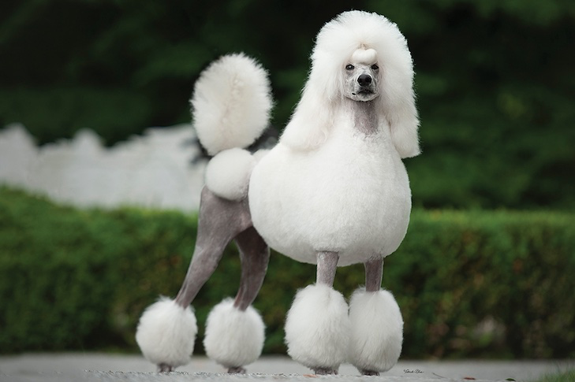
Notes:
Poodle

Slide 12
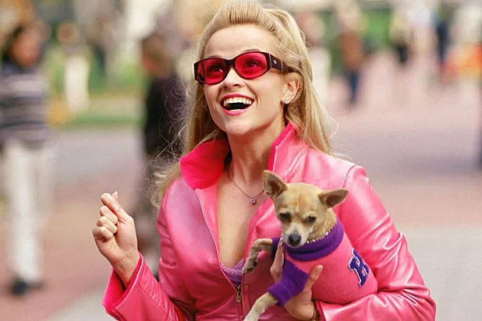
Notes:
Bruiser Woods

Slide 13
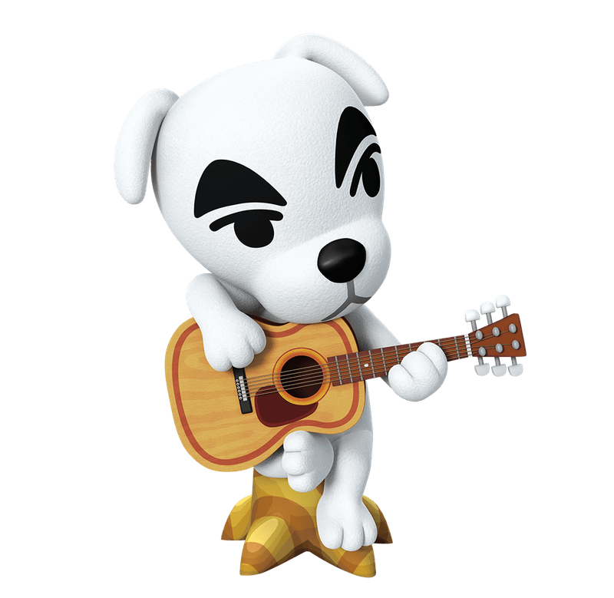
Notes:
KK Slider

Slide 14

Notes:
Beethoven

Slide 15

Notes:
Lassie

Slide 16
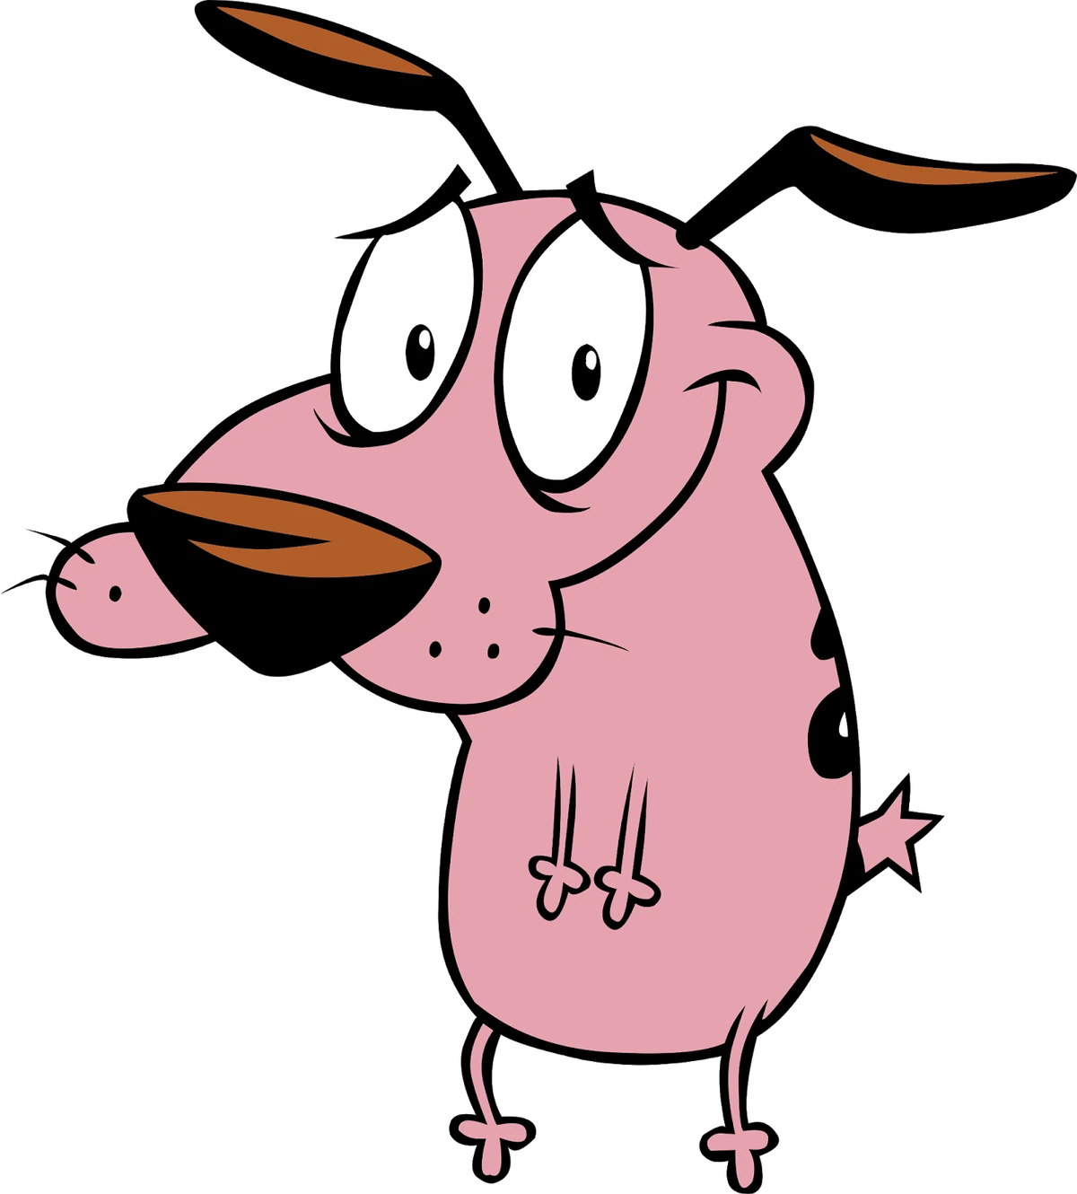
Notes:
Courage

Slide 17
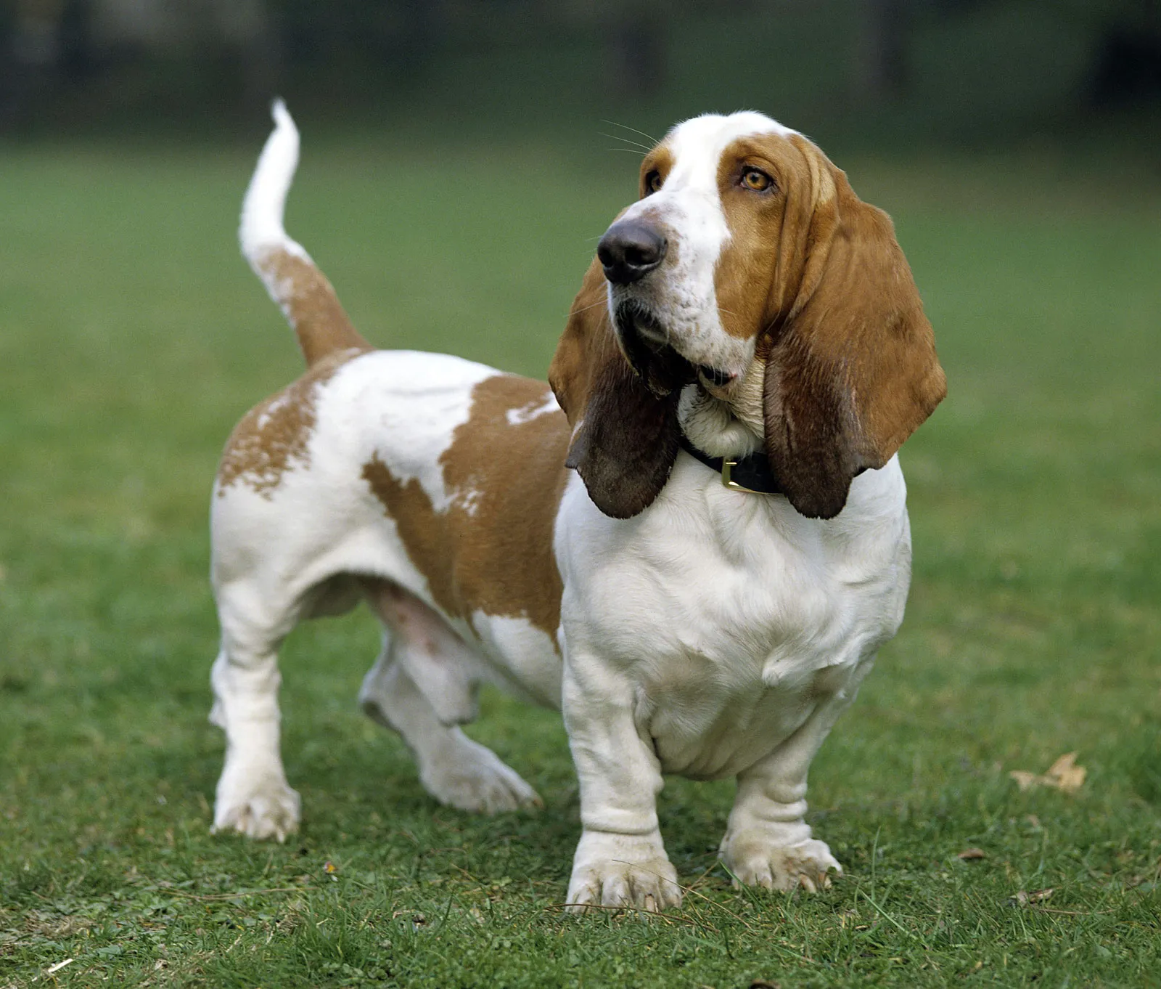
Notes:
Basset Hound

Slide 18
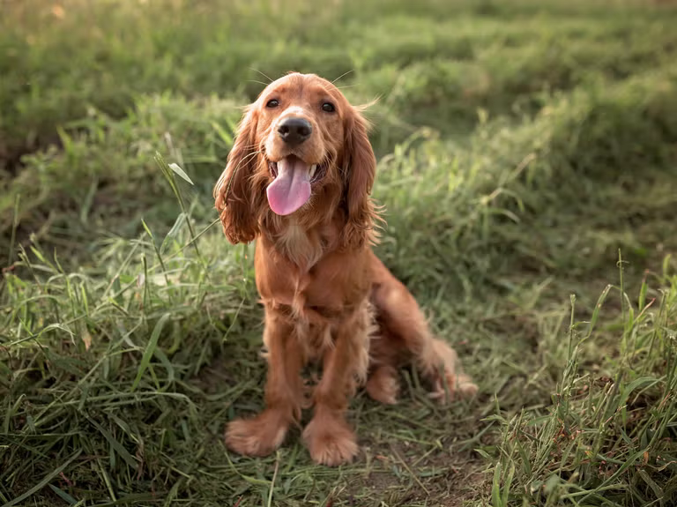
Notes:
Cocker spaniel

Slide 19
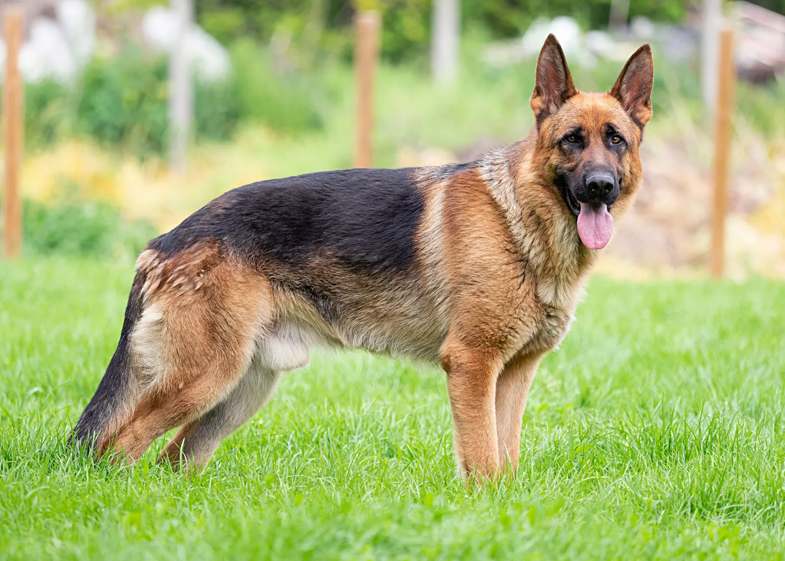
Notes:
German Shepherd

Slide 20
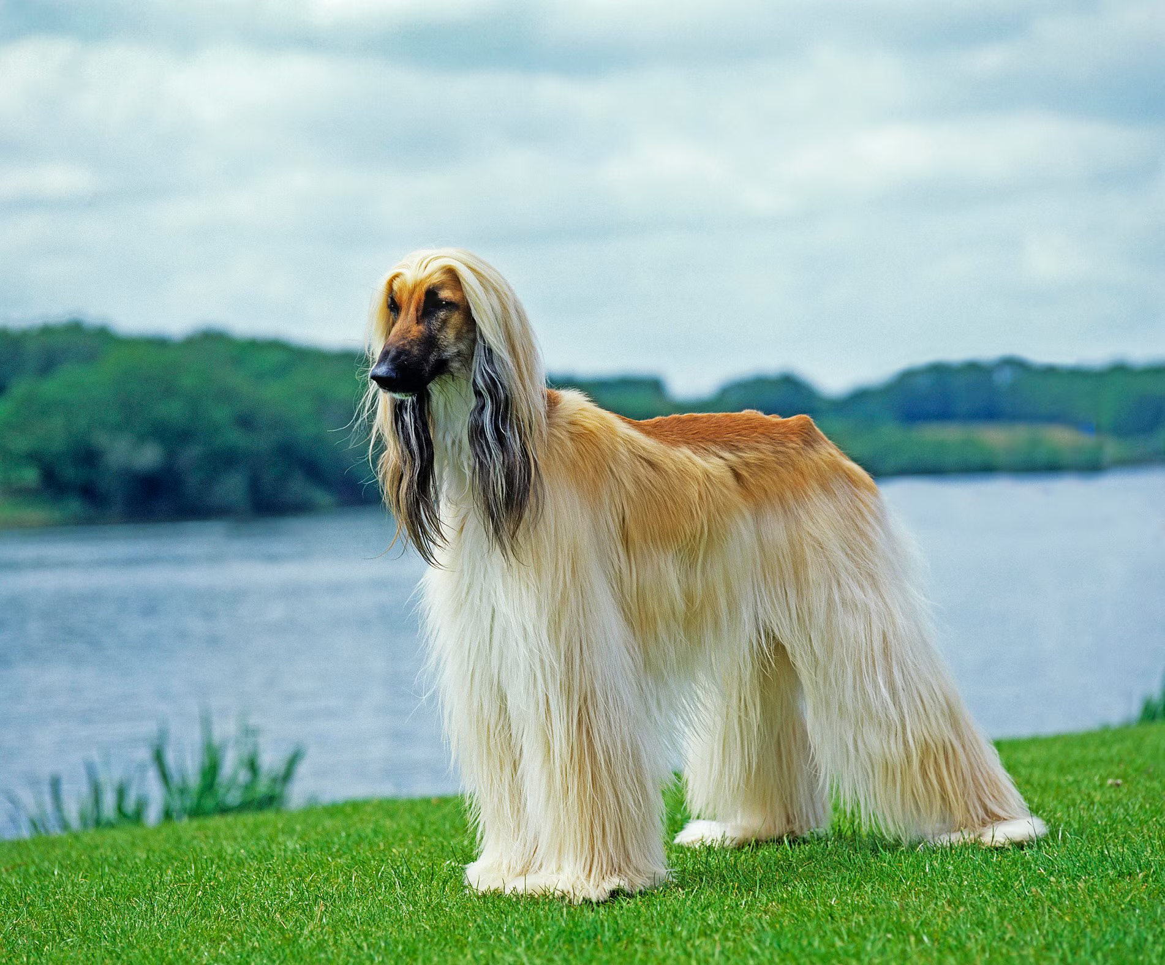
Notes:
Afghan hound

Slide 21
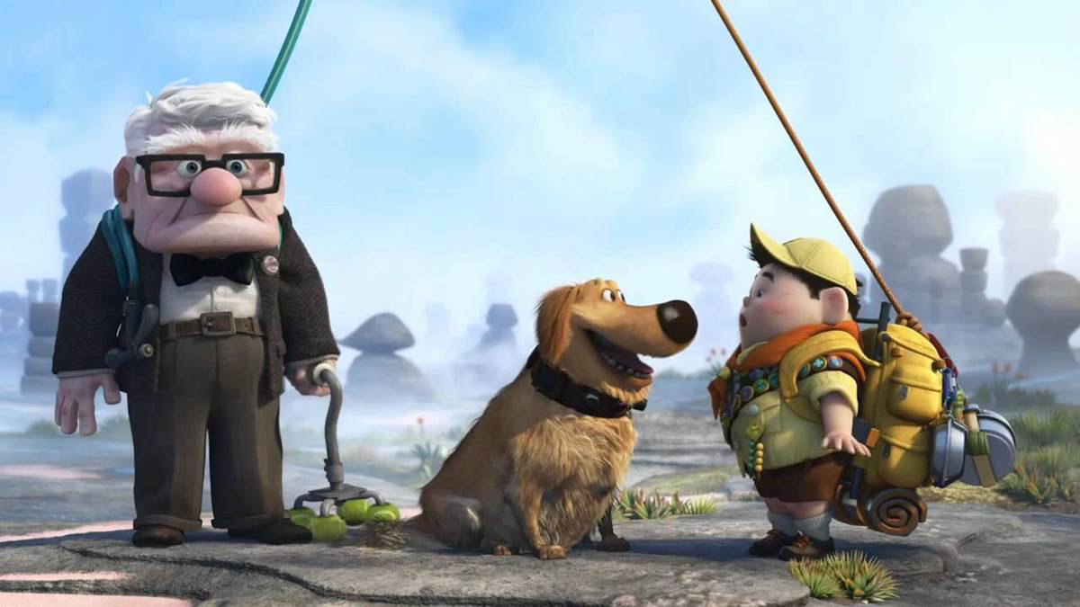
Notes:
Dug

Slide 22
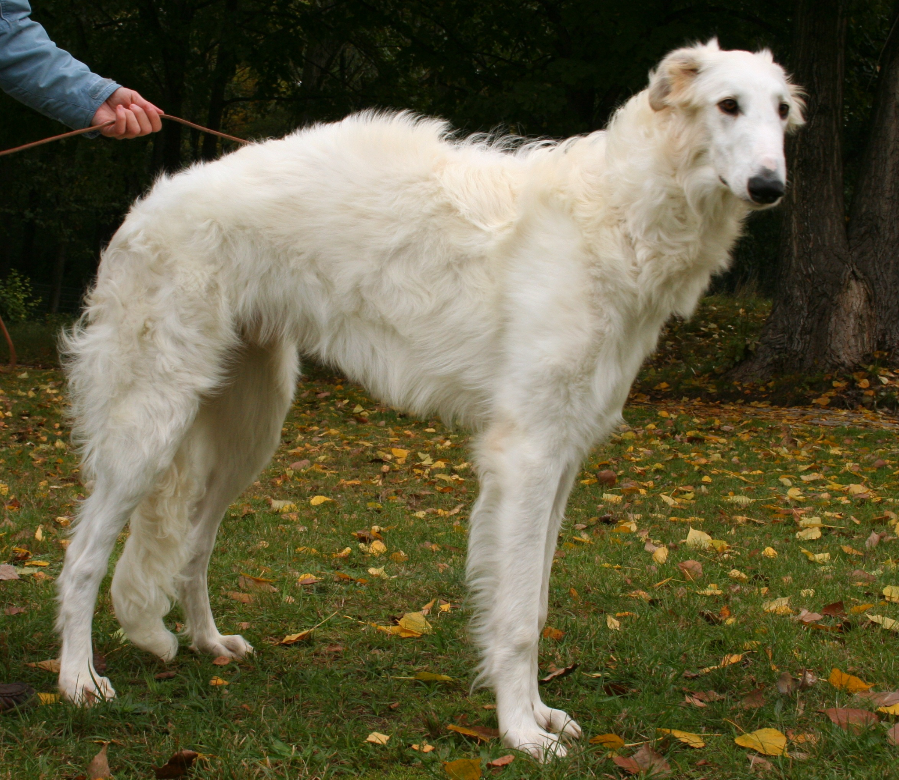
Notes:
Borzoi

Slide 23
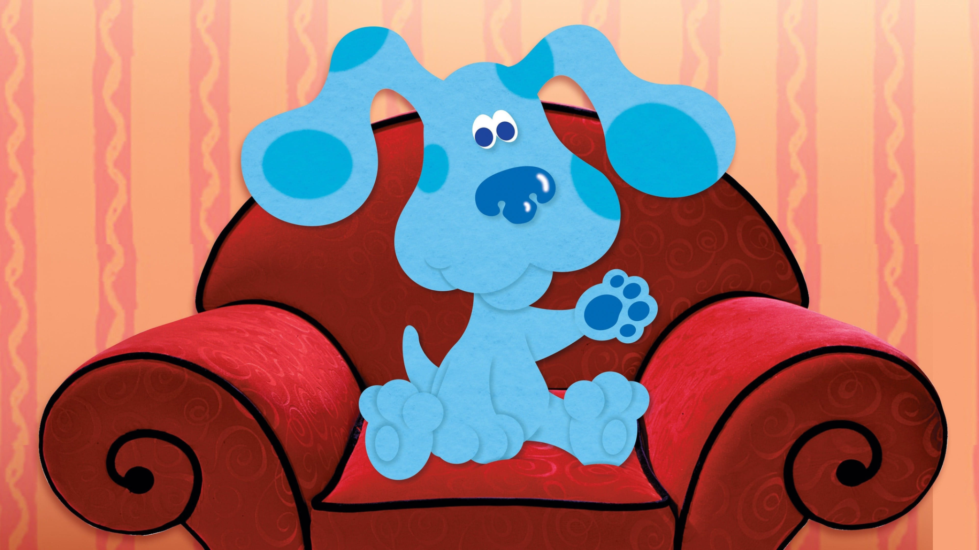
Notes:
Blue

Slide 24
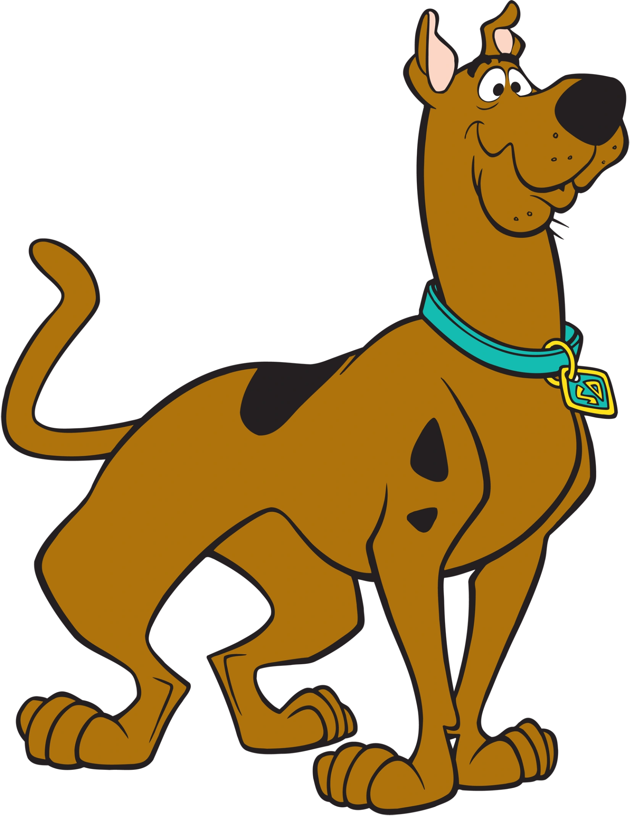
Notes:
Scooby Doo

Slide 25
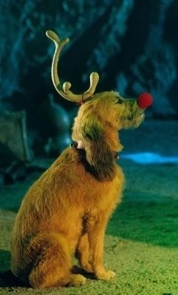
Notes:
Max

Slide 26
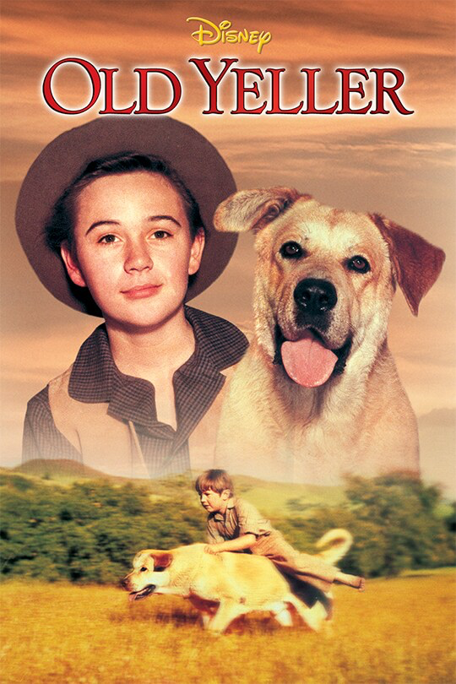
Notes:
Old Yeller

Slide 27
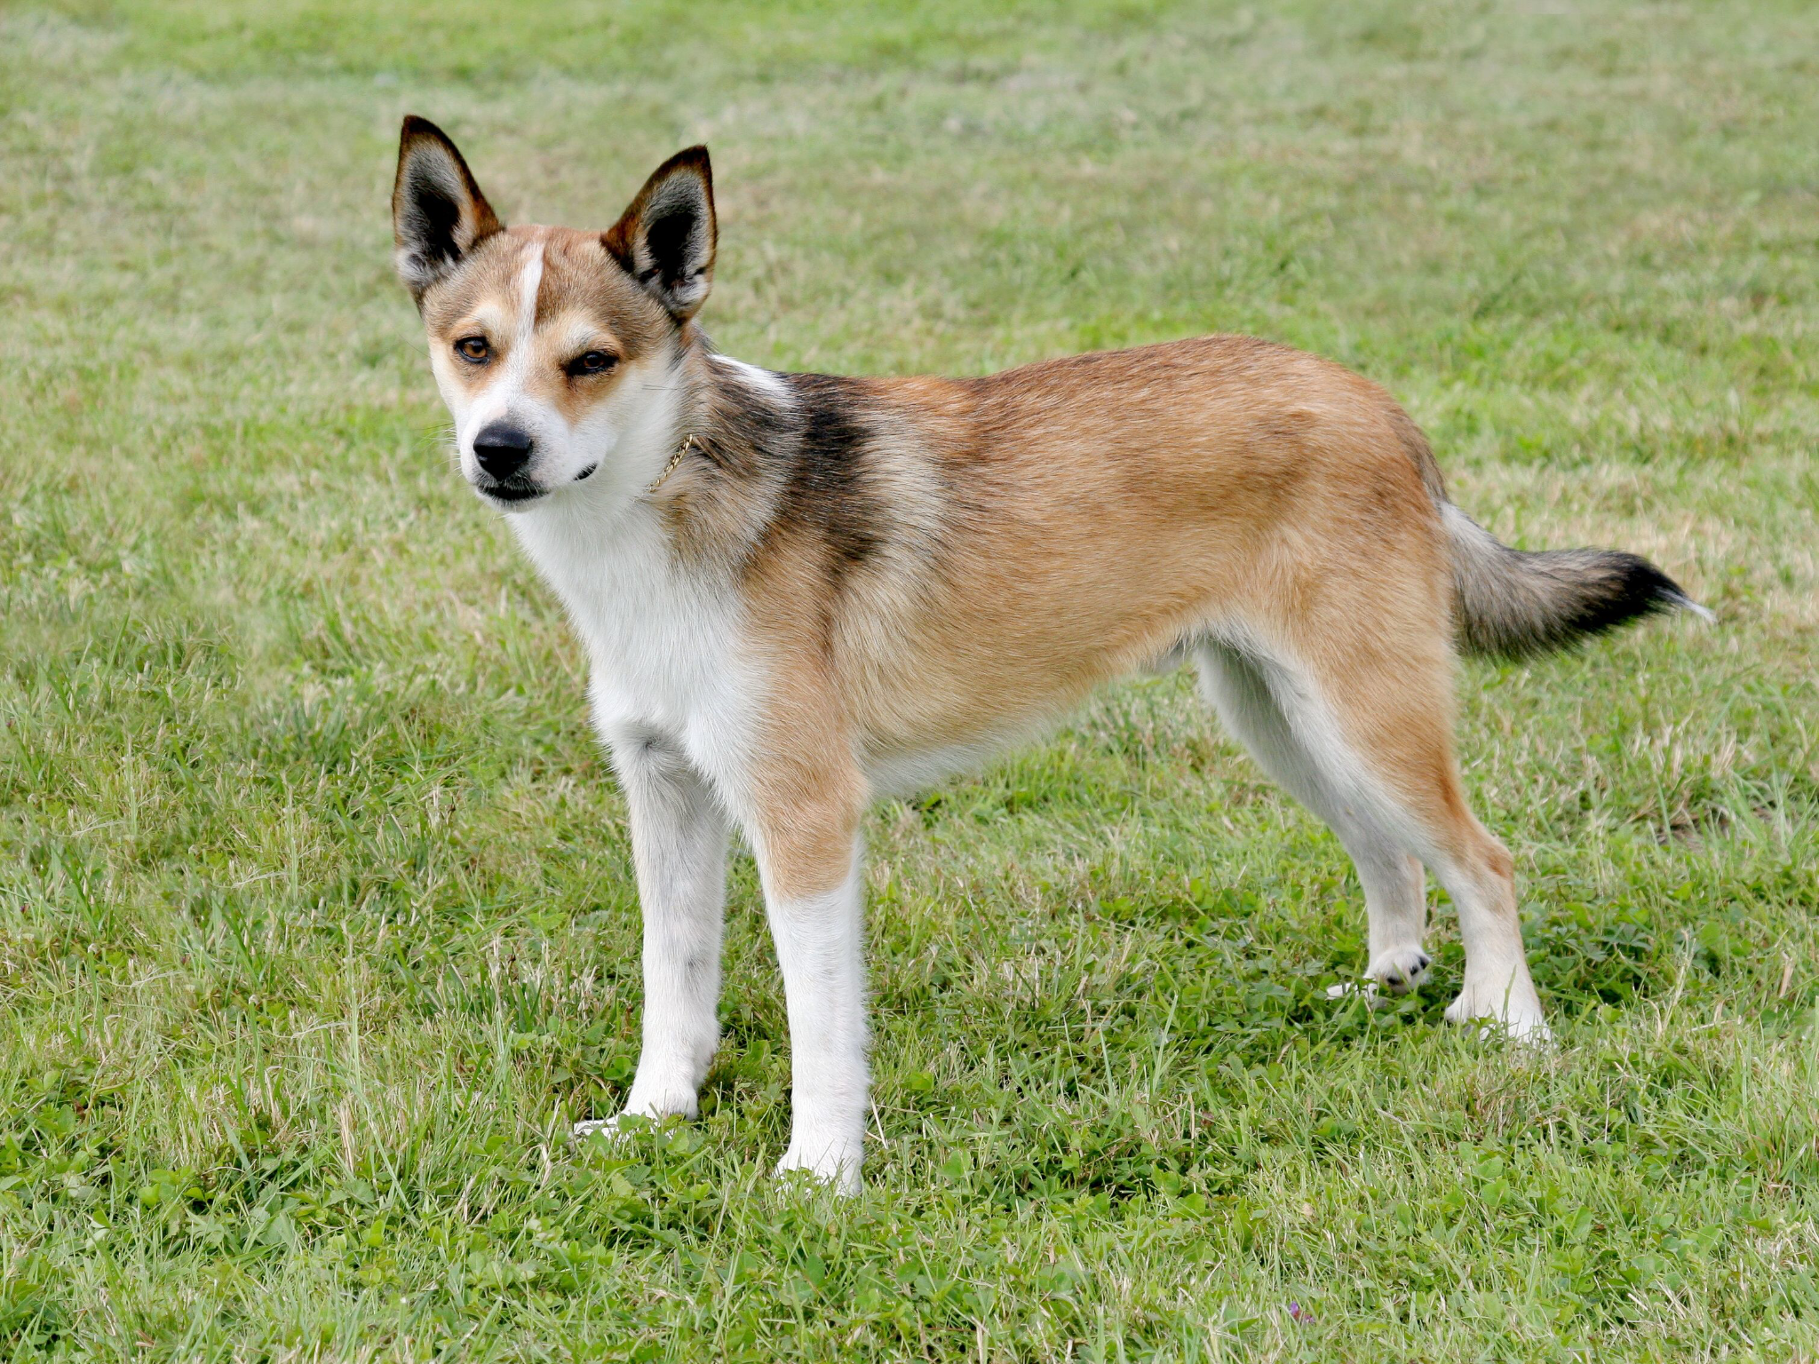
Notes:
Norwegian Lundehund

Slide 28

Notes:
Odie

Slide 29

Notes:
Marley

Slide 30
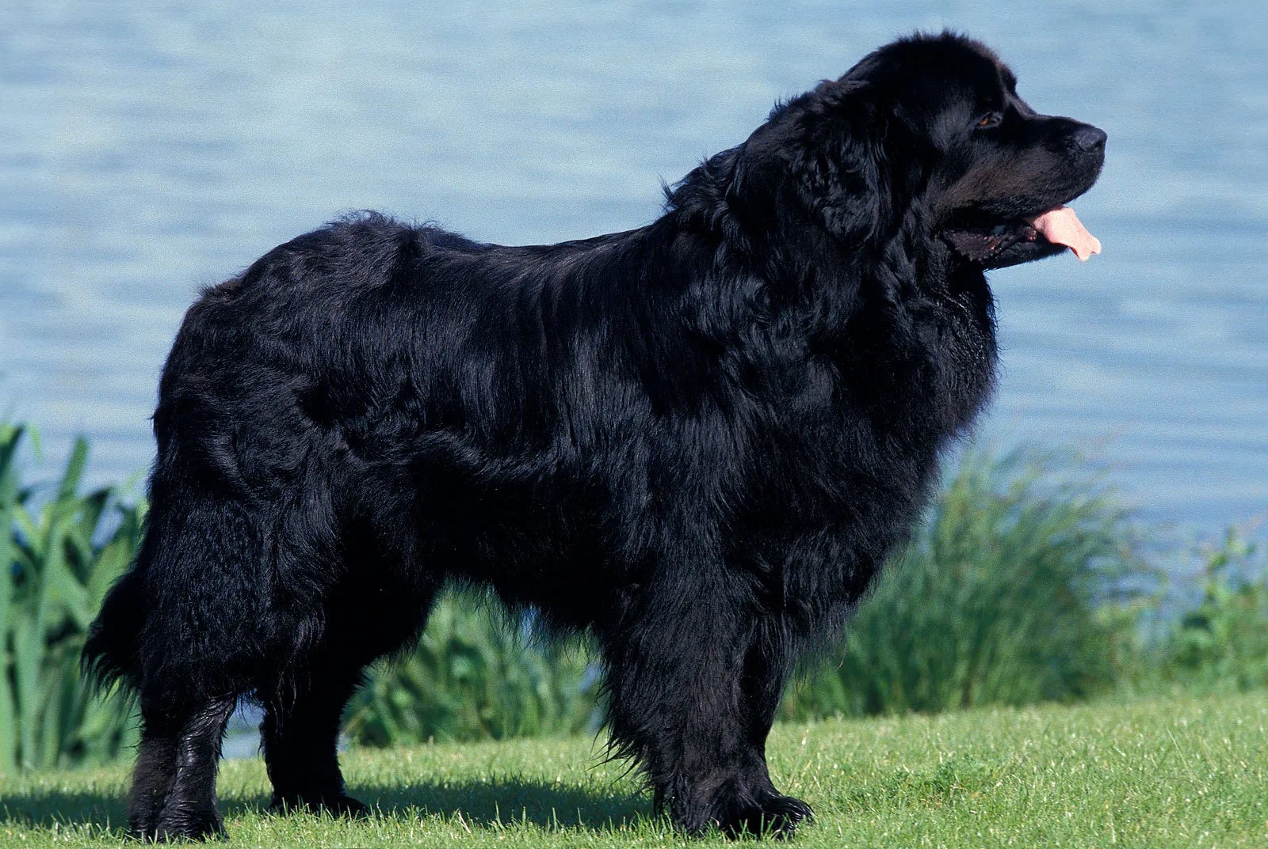
Notes:
Newfoundland

Slide 31
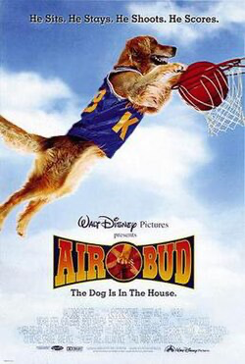
Notes:
Air Bud

Slide 32
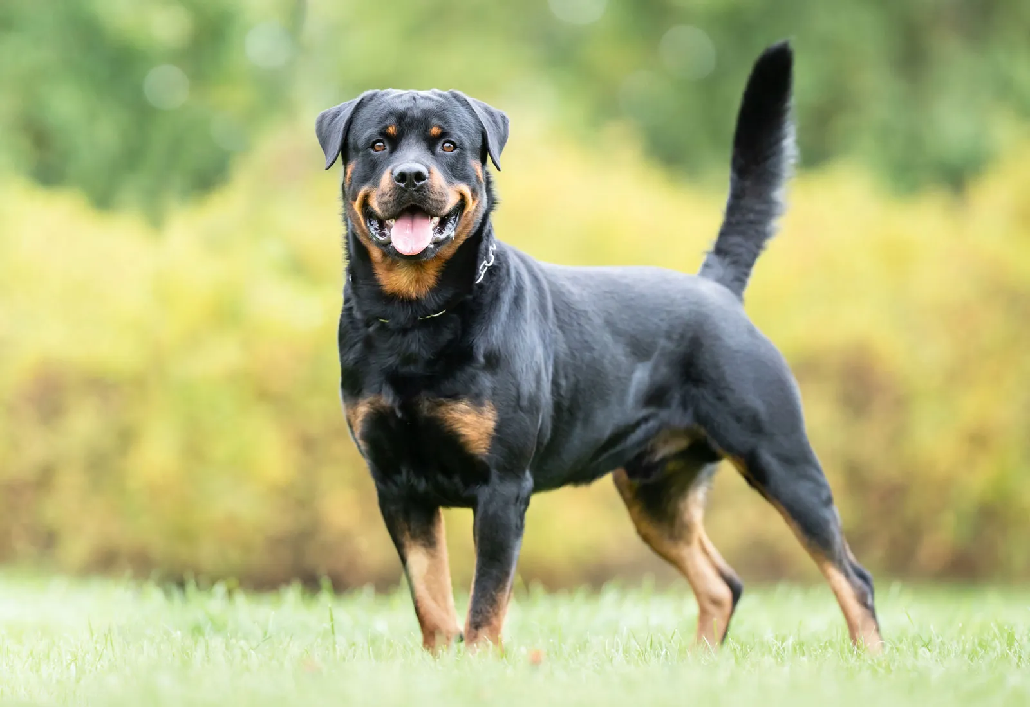
Notes:
Rottweiler

Slide 33

Notes:
Bolt

Slide 34
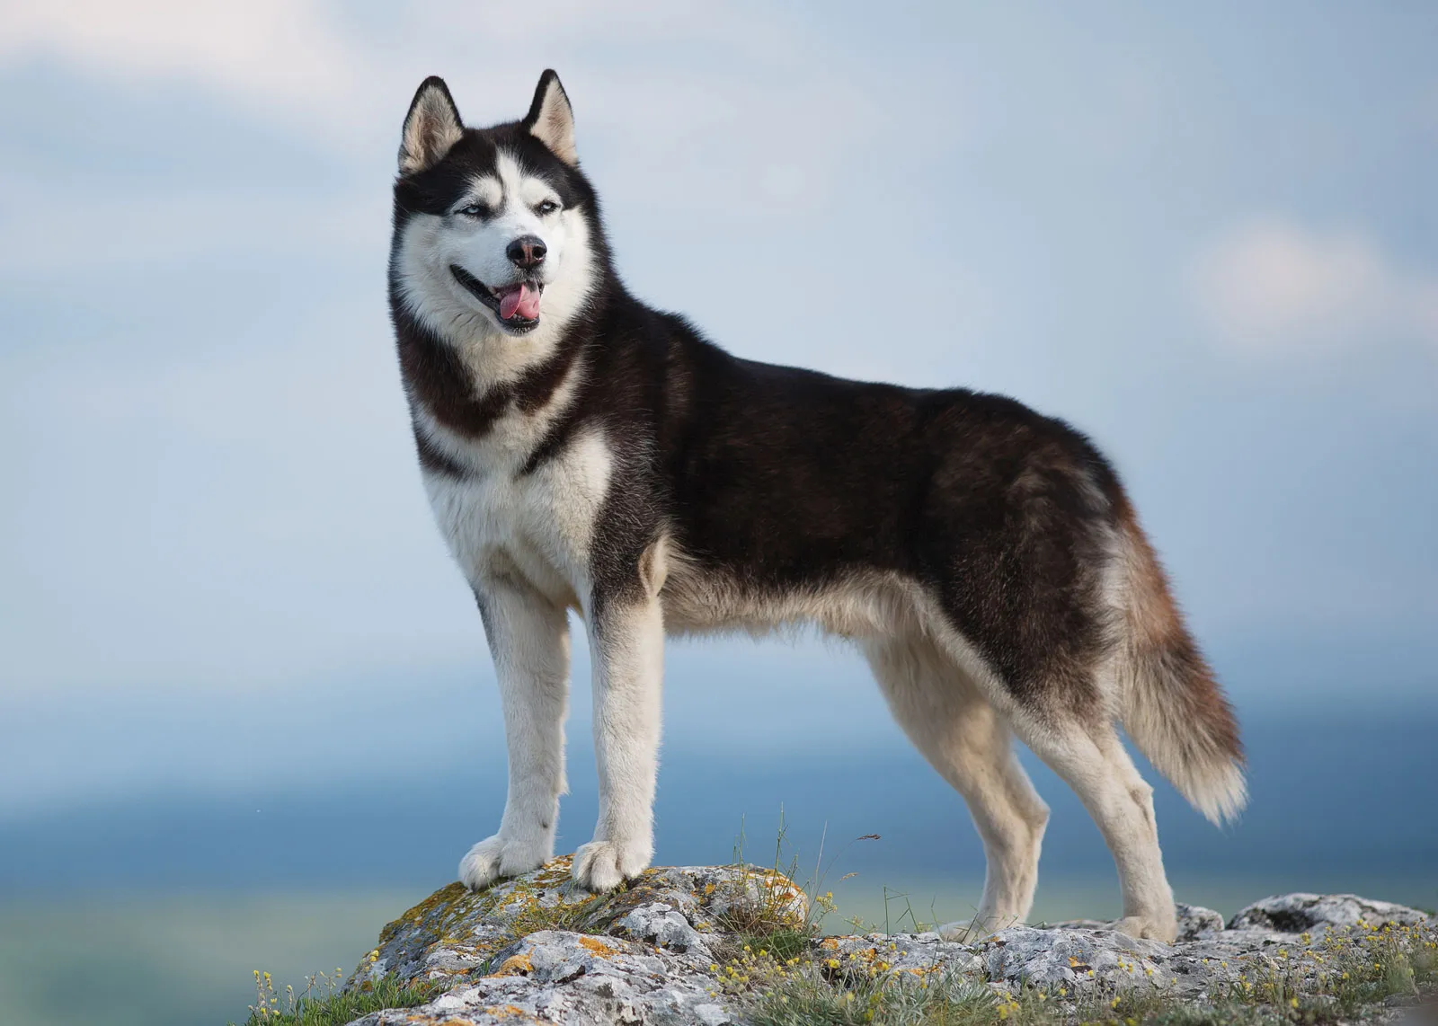
Notes:
Husky

Slide 35
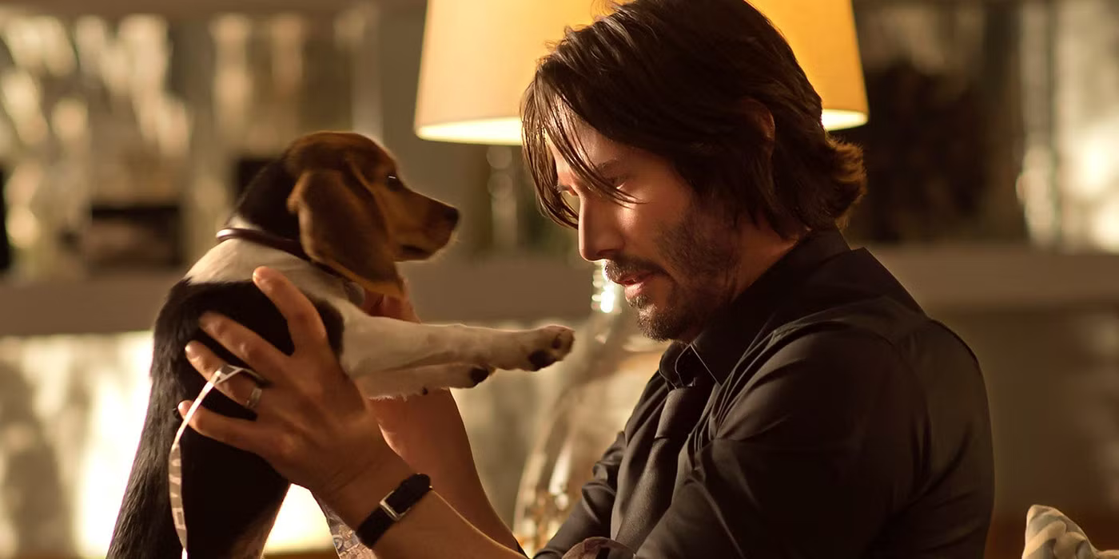
Notes:
Daisy

Slide 36
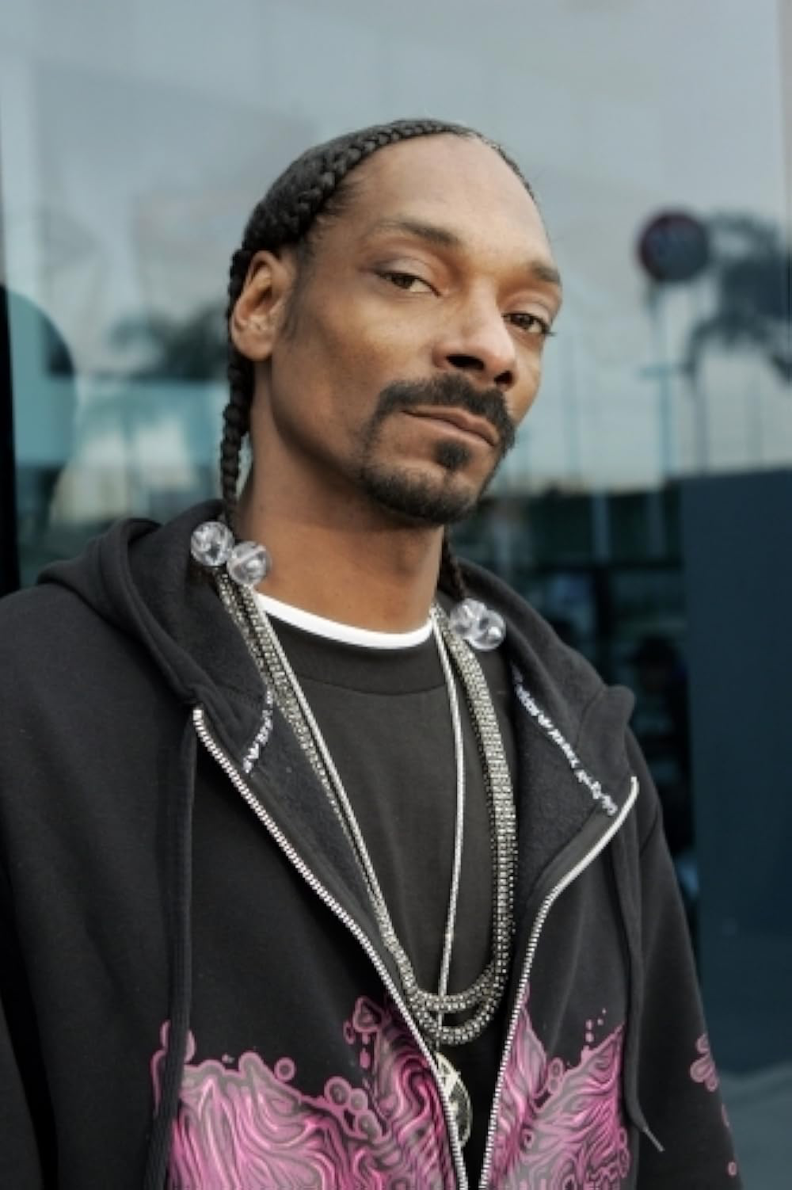
Notes:
Snoop Dogg

Slide 37
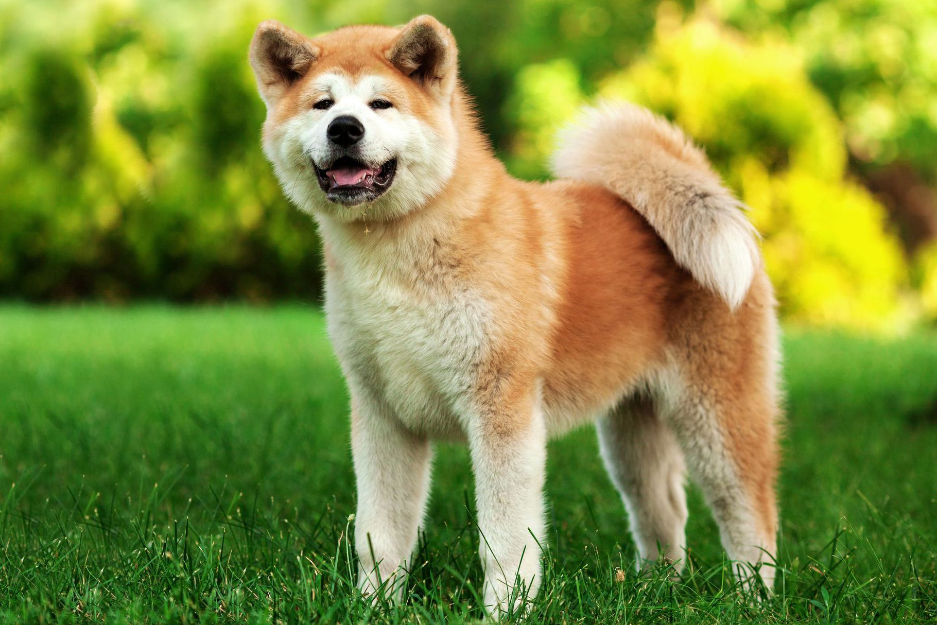
Notes:
Akita

Slide 38
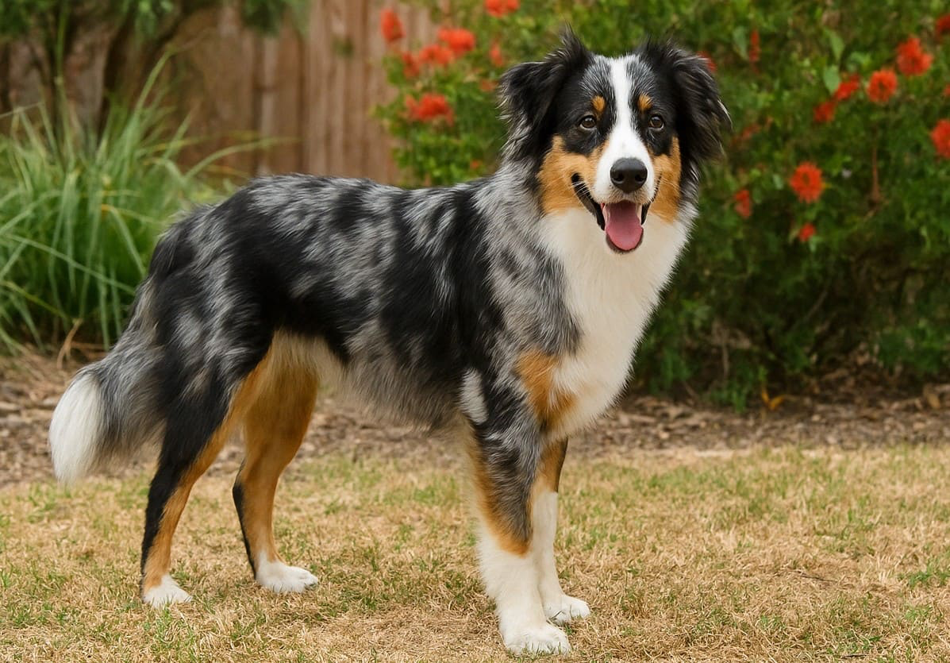
Notes:
Australian shepherd

Slide 39
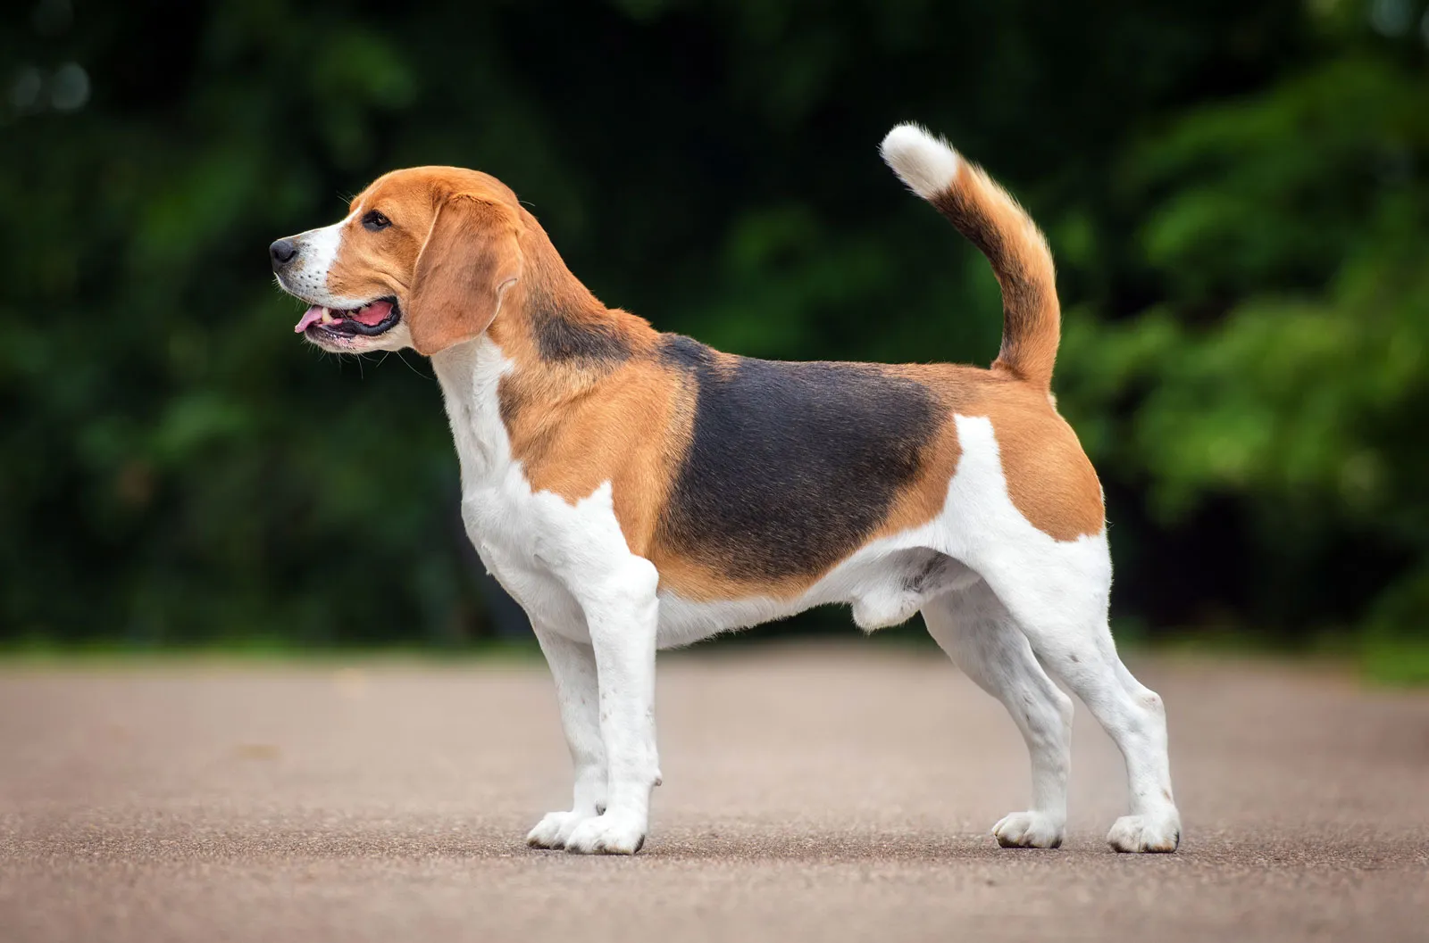
Notes:
beagle

Slide 40

Notes:
Chase

Slide 41
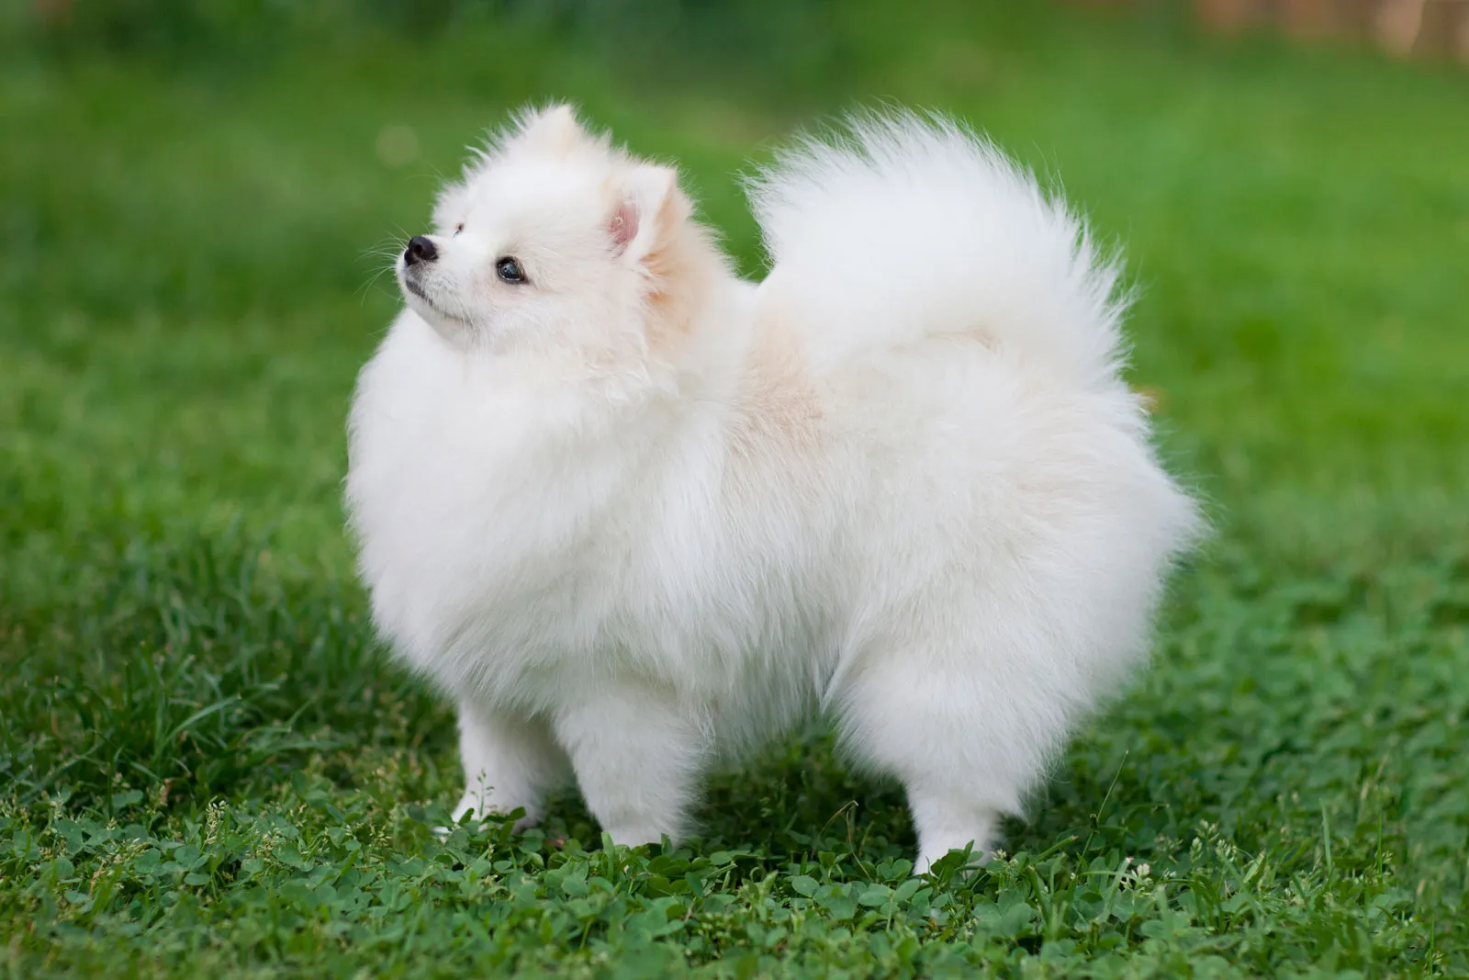
Notes:
Pomeranian

Slide 42
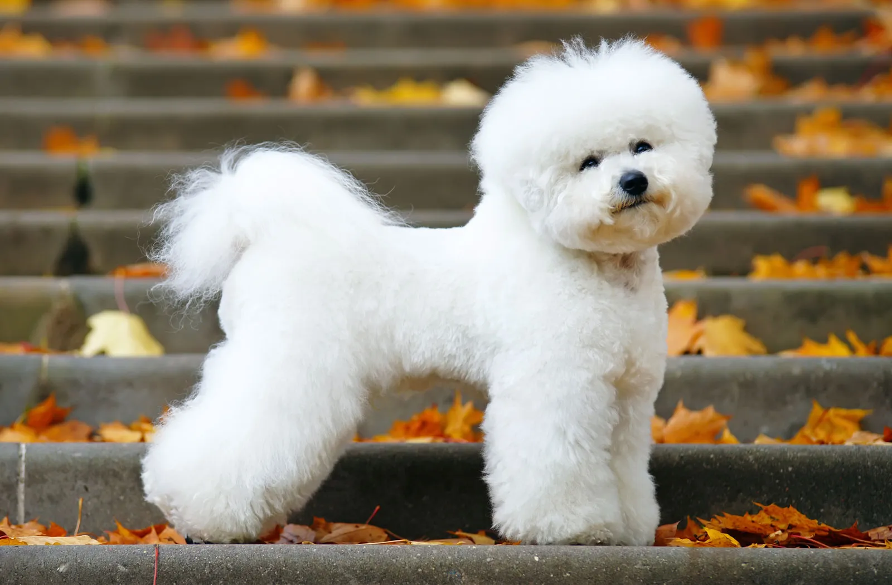
Notes:
Bichon frisé

Slide 43
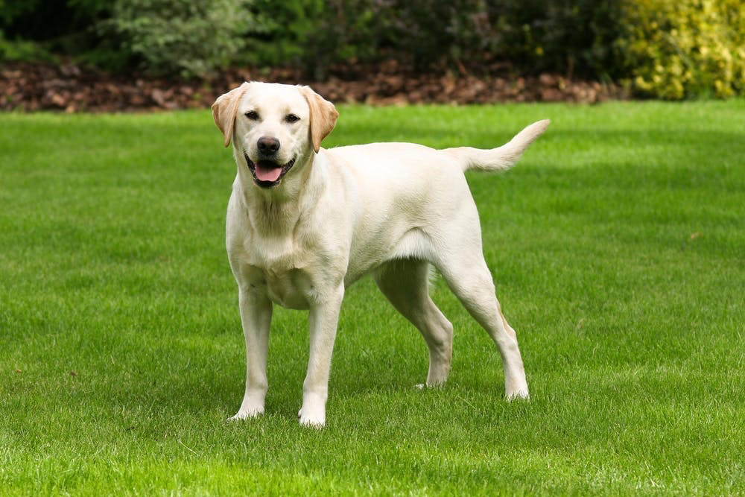
Notes:
Lab(rador retriever)

Slide 44
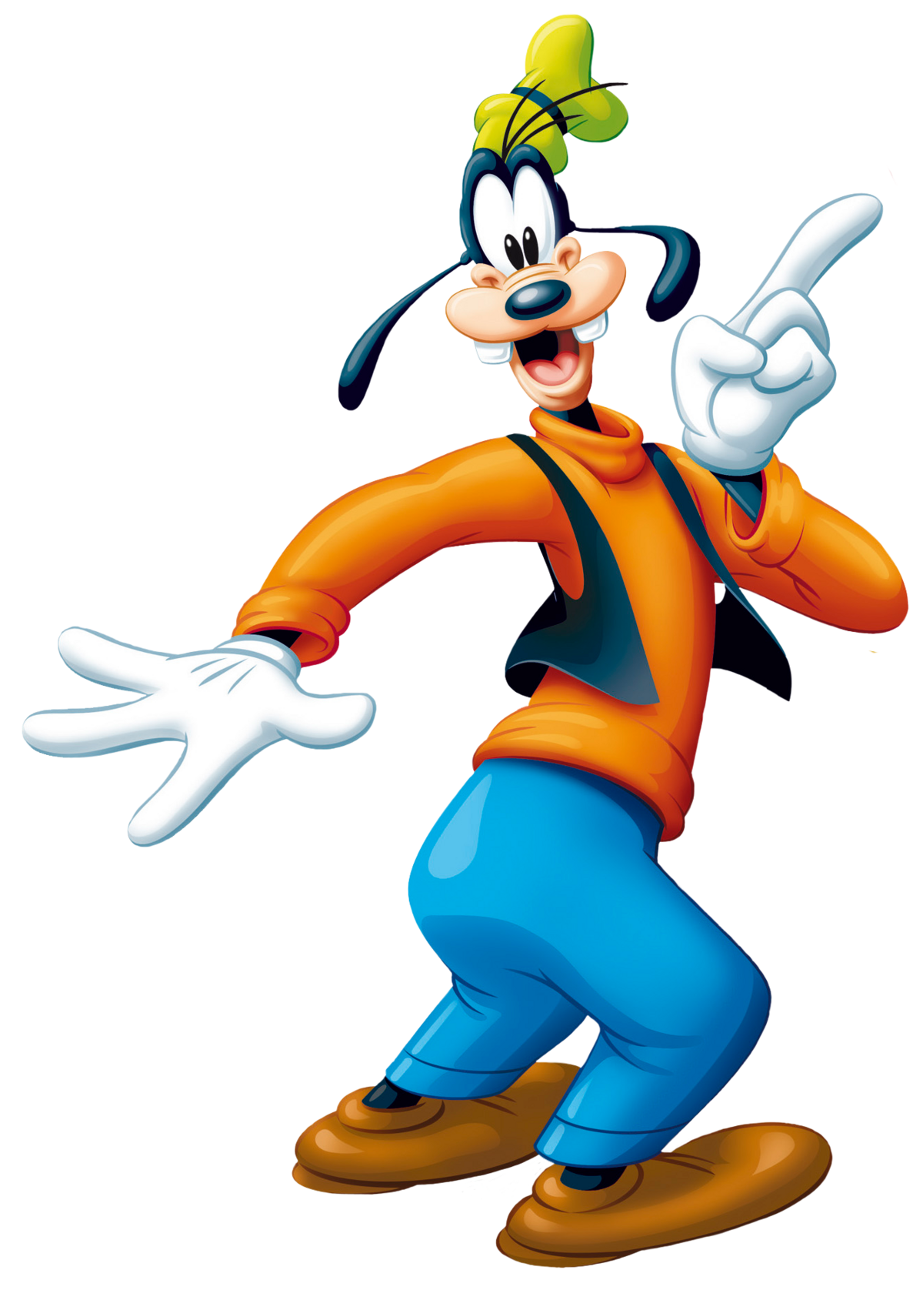
Notes:
Goofy

Slide 45
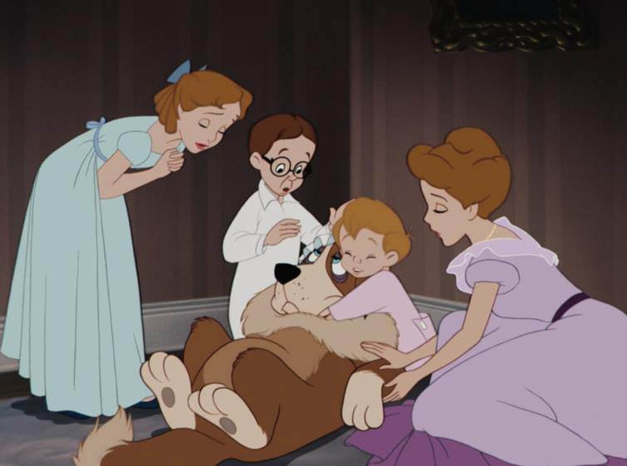
Notes:
Nana (Peter Pan)

Slide 46
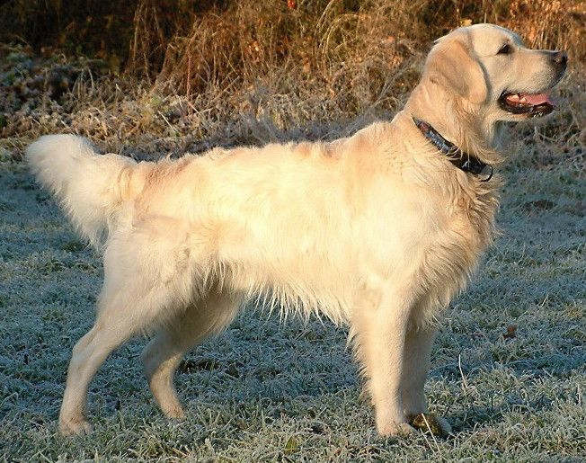
Notes:
Golden retreiver

Slide 47
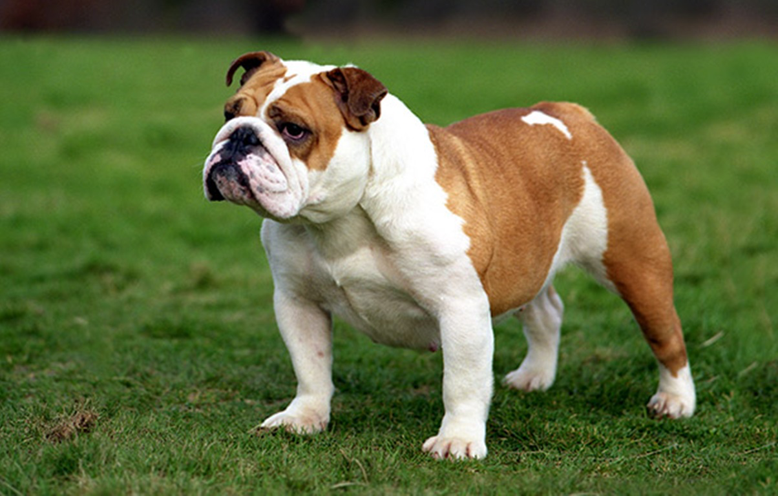
Notes:
Bulldog

Slide 48
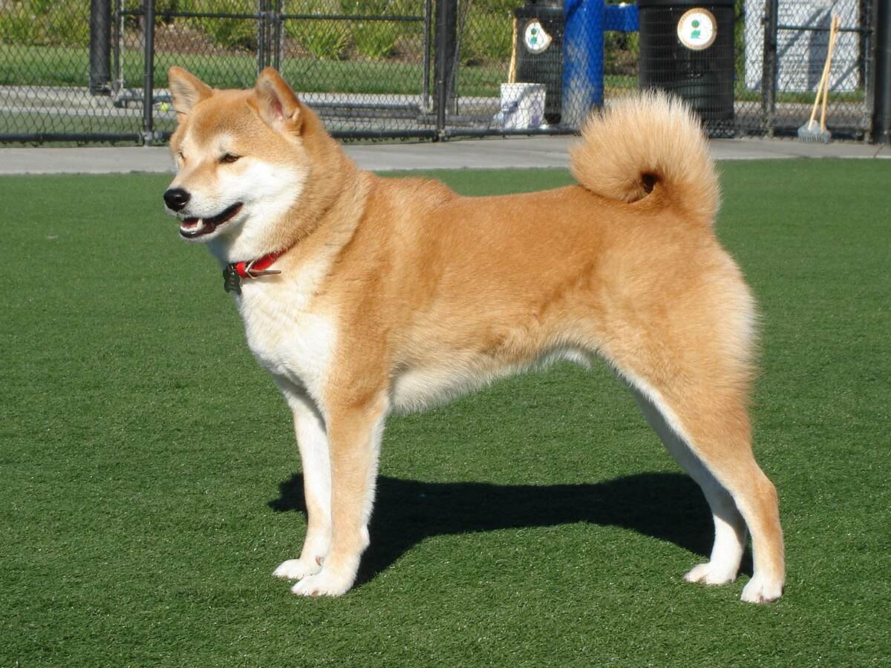
Notes:
Shiba Inu

Slide 49
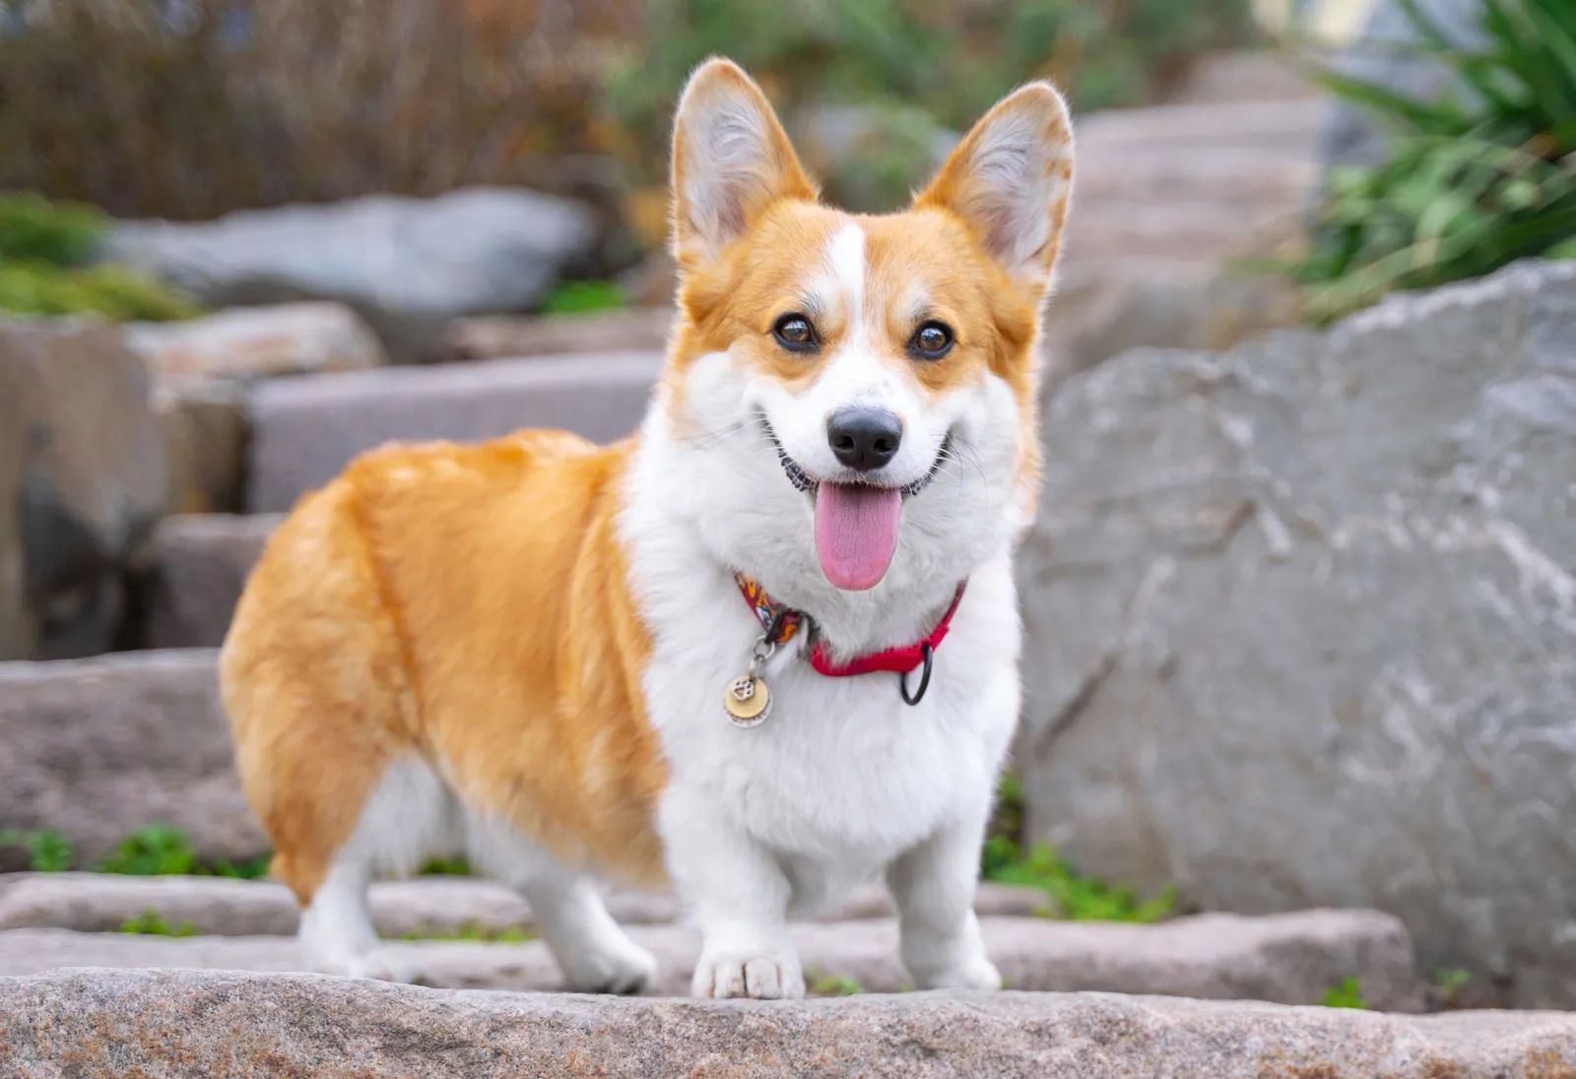
Notes:
Corgi

Slide 50
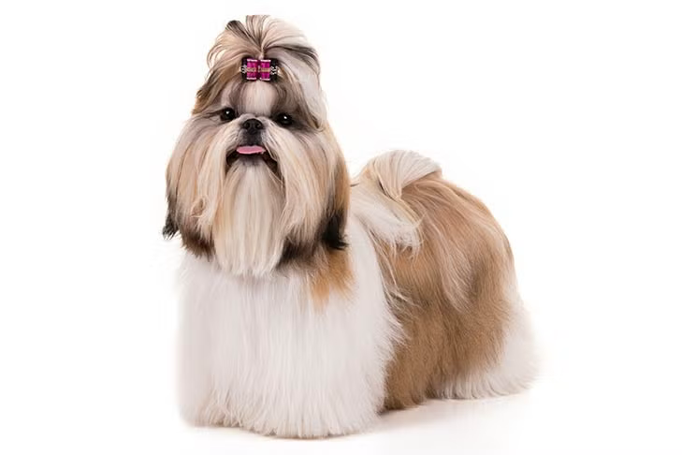
Notes:
Shih Tzu

Slide 51

Notes:
Bluey

Slide 52
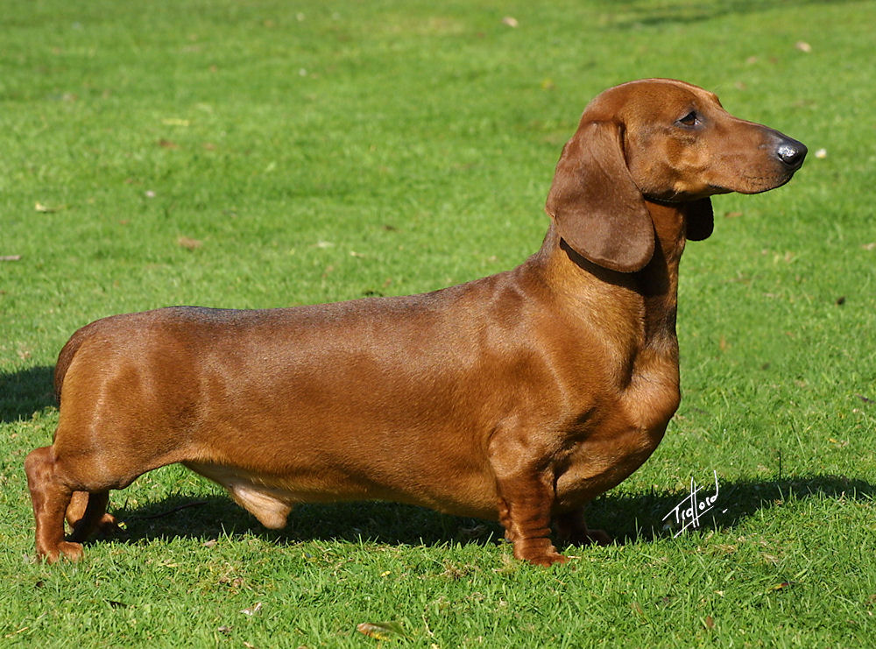
Notes:
Dachshund

